Slide 1
L2 - Knowledge sharing
FT 517, 523, 792, 1796
TDD/FDD
Artur Ekert
22.04.2020

Slide 2
Abbreviations
ACK Acknowledgment
ATB AdaptiveTransmissionBandwidth
BLER Block Error Rate
CRC cyclicredundancycheck
CSI-RS Channel StateInformation-Reference Signals
CQI Channel QualityIndicator
HARQ HybridAutomatic RetransmissionRequest
ILLA Inner LoopLink Adaptation
MCS Modulationand CodingScheme
SU-MIMO Single User Multiple-Input Multiple-Output
MU-MIMO Multi User Multiple-Input Multiple-Output
NACK NegativeAcknowledgment
OLLA Open LoopLink Adapatation
PHR Power Headroom Report
PTRS PTRS Phase Tracking Reference Signa
QAM QuadratureAmplitudeModulation
QPSK QuadraturePhaseShiftKeying
SINR Signalto Interferenceplus NoiseRatio

Slide 3
Presentation Plan
Where is what you’re looking for
BIP L1L2
Wireshark
TTI trace
TTI trace decoding
Sherpa
DDR4 Capture
MUE TDD logs analysis
MUE FDD logs analysis
eLA FDD logs analysis
Q&A
Useful links

Slide 4
Basic Knowledge
5GC000523 TDD scheduler for Multi-UE support
5GC000517 Uplink and downlink link adaptation
5GC001796 Enhanced Link Adaptation procedures
5GC000792 FDD scheduler for Multi-UE support

Slide 5
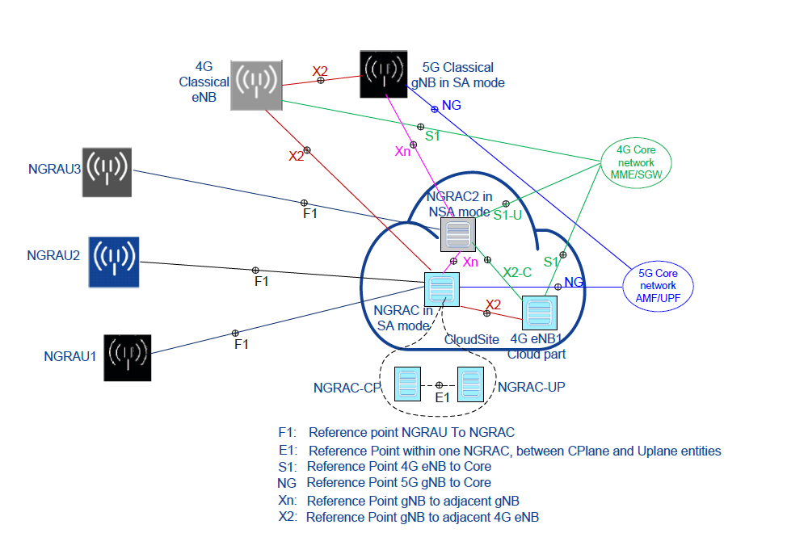
Where is what you’re looking for?

Slide 6
Where is what you’re looking for?
 | Snapshot/ Journalctl | BTSLog | UE Log | X2 | S1/Ng | BIP/Egen | L2-PS TTI | SHERPA | DDR | RFSW calibration
Tput | X | X | X | X | X | X | X | X
Attach | X | X | X | X | X | X | X | X
Detatch | X | X | X | X | X | X | X | X
Reset | X | X
PMStats | X
RACH | X |  | X |  |  | X | X | X | X | X
Beam Mgmt | X |  |  |  |  | X | X | X |  | X
GPS | X | X
NotOnAir | X | X |  | X | X
https://confluence.int.net.nokia.com/display/CV/5gNB+Logs+collection+and+troubleshooting

Slide 7
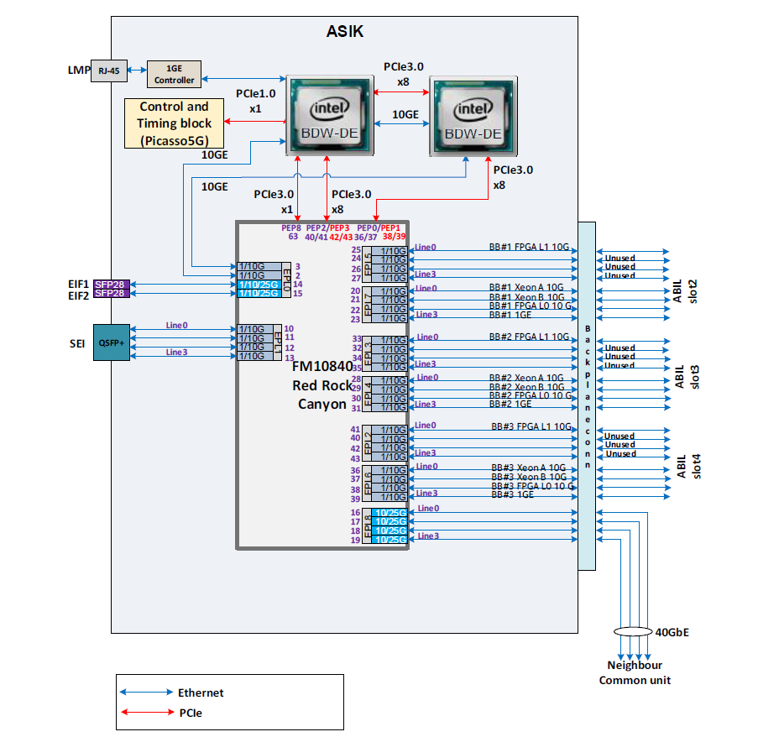
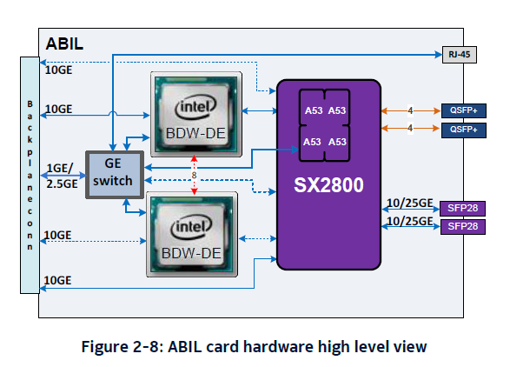
How to Collet BIP L1-L2 log – Red Rock Canyon

Slide 8
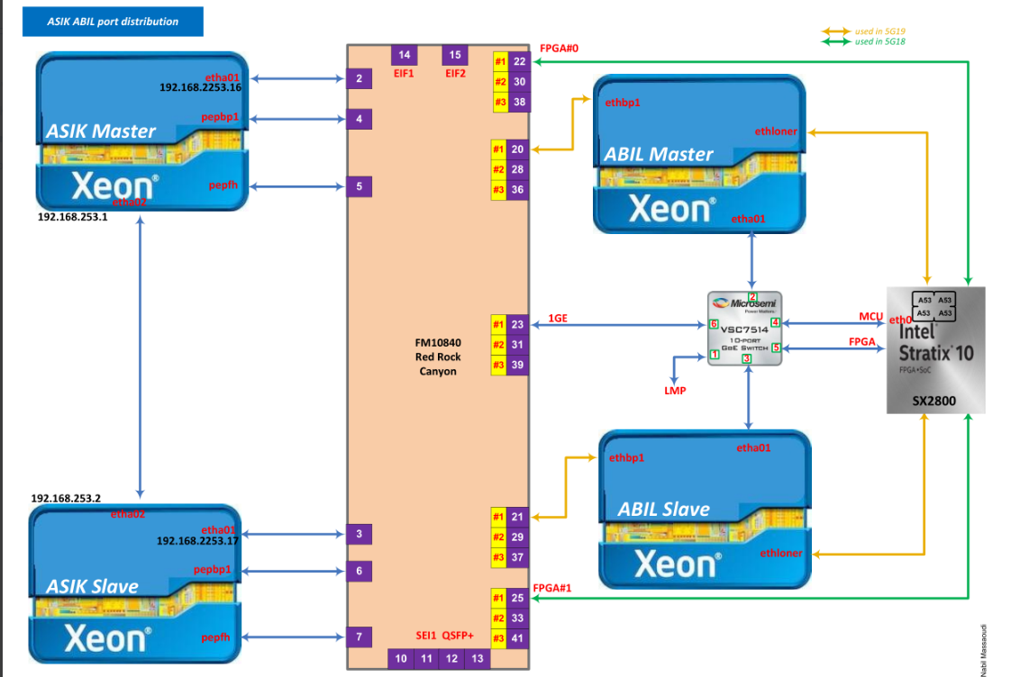
How to Collet BIP L1-L2 log – Red Rock Canyon
On ASIK
#dbgrrc mirror sport <port_num> dport <port_num> <e|d> [i|e|b]
[vlan <vlan_number>]
with:
e|d standing for enable|disable
i|e|b standing for ingress|egress|both
<port_num> : RRC port
Eexample : to check what is sent from eth2 BB2 which should
be received by RRC EIF2 port (source port 15)
to ABIL master xeon (dest port 20) we performed,
on ASIK following commands
#dbgrrc mirror sport 15 dport 20 e b
#tcpdump port 20
https://confluence.int.net.nokia.com/display/OPSW1/ASIK+Red+Rock+Canyon+%28RRC%29+ports+distribution
https://confluence.int.net.nokia.com/display/MANO/ASIK

Slide 9
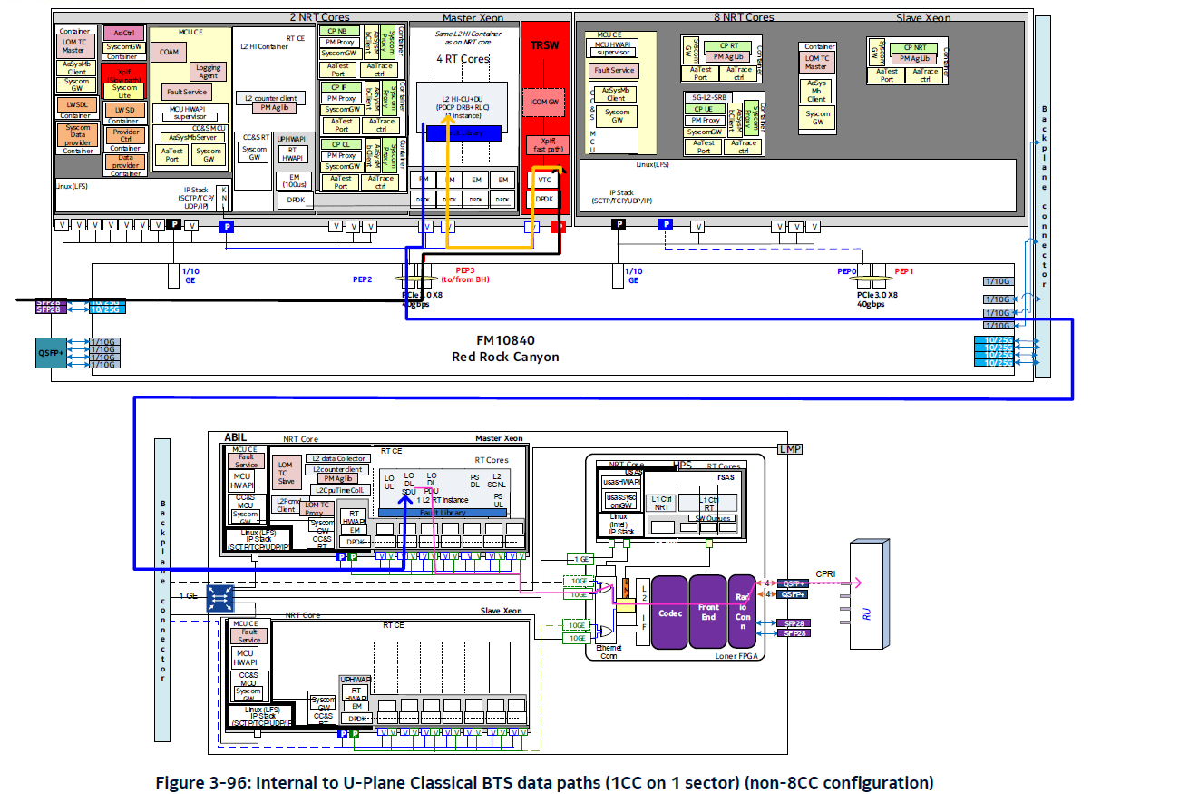
How to Collet BIP L1-L2 log – data paths

Slide 10
ASIK bsh/bget command (substitute of ssh / scp)
bsh [-t <timeout_in_sec>] [-b] [[<domainId>:]<boardId>:]<socId> [<command> [args...]]
bsh 0 sesja na XEON master ASIKa (192.168.253.16)
bsh 1 sesja na XEON slave ASIKa (192.168.253.17)
bsh 1:0 sesja na XEON A ABILa (192.168.253.20)
bsh 1:1 sesja na XEON B ABILa (192.168.253.21)
bsh 1:2 sesja na Lonera ABILa (192.168.253.22)
bget [-t <timeout_in_sec>] [[<domainId>:]<boardId>:]<socId> <remote-file> <local-dir>
eg. To download log.txt from Loner to ASIK Master tmp dir, you can use command:
root@fct-0a:~ >bget 1:2 /tmp/log.txt /tmp/

Slide 11
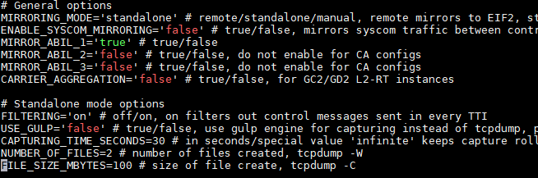
How to Collet BIP L1-L2 log
Download mirror scripts: \\eseefsn50.emea.nsn-net.net\rotta4internal\5G\Oulu_L3_CAMP\gnbMirroring
Copy scripts to ASIK Xeon Master: /ffs/run/config/scripts/
Configure parameters, and start logs collecting – edit gnbMirroringConfig.sh
Capturing on ASIK
Add execution right to the file: chmod +x gnbMirroring.sh
Run script: ./gnbMirroring.sh -> capturing will be stopped after „CAPTURING_TIME_SECONDS”

Slide 12
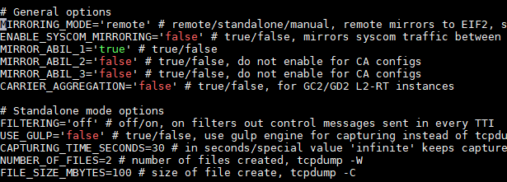
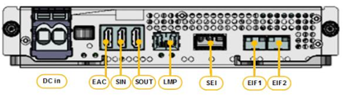

How to Collet BIP L1-L2 log
Capturing on external sniffer
Add execution right to the file: $chmod +x gnbMirroring.sh
Run script: $./gnbMirroring.sh ->
You can execute command remotly eg. sshpass -p oZPS0POrRieRtu ssh -A -t toor4nsn@10.42.555.444 '/ffs/run/config/scripts/gnbMirroring.sh’
Start tcpdump on connected to ASIC interface eg. #tcpdump -i ens1f1 -w name_of_file.pcap -C 100M
Stop collecting after the test (kill tcpdump process)
Configure MTU on network interface to 9216
# ifconfig ens1f1 mtu 9216
Or edit interface config file

Slide 13
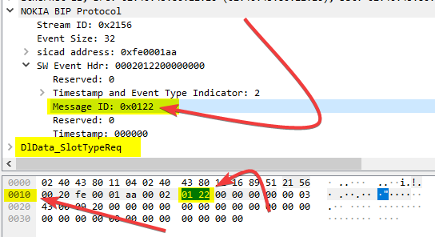
How build tcpdump/WS capture filter
Capture BIP without any filter
Open it and decode
Check payload of msg which is needed/not needed
Build tcpdump capture command:
tcpdump -i ens1f0 'ether[0x18:2]!=0x122 ' -w log.pcap
Example pcap filter for FDD SA:
tcpdump -i ens1f0 'ether[0x18:2]!=0x122 && ether[0x18:2]!=0x240 && ether[0x18:2]!=0x127' -w log.pcap
Moore complex bash script to read/write filtered .pcap file:
Count of crc err in harqU msg:
tcpdump -r BIP.pcap 'ether[0x18:2] = 0x0218 && ether[0x38:1] = 0x01' -w tmp.pcap; capinfos tmp.pcap -c –M; rm -f tmp.pcap

Slide 14
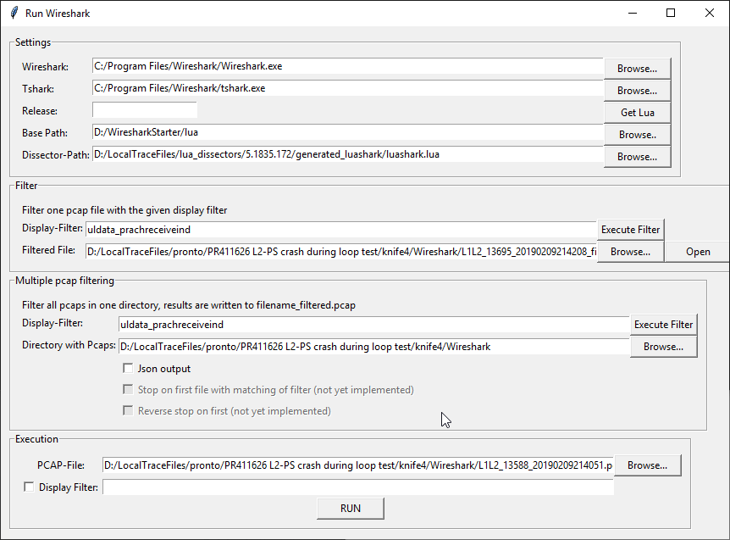
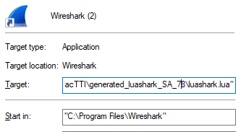
How to decode L1-L2 BIP .pcap
Tools:
Wireshark LTE-5G
Luashark -> Can be download from WFT or Artifactory
How to run Luashark? -> execute command in cmd: C:\Program Files\Wireshark\Wireshark.exe" -X lua_script:C:\path\to\luashark.lua C:\path\to\file.pcap
You can use WiresharkStarter, or config WS Shortcut:
In „Target” field, paste execute command

Slide 15
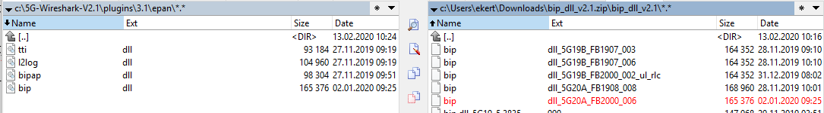
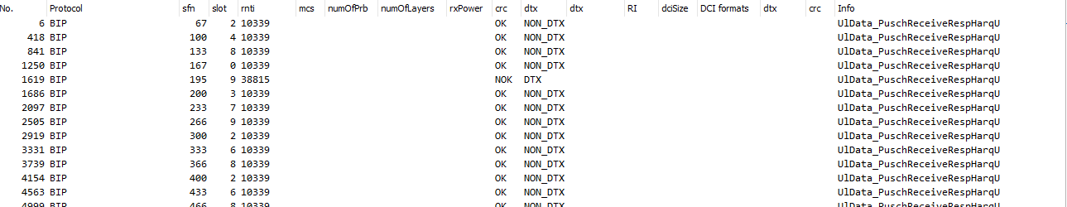
How to decode L1-L2 BIP .pcap – 5G-Wireshark
5G-Wireshark (nokia-sbell) -> NOT SUPPORTED
Download bip_dll_v2.1.zip which can be download from the same location
Replace old bip.dll with a proper to your gNB SW release
(do not forget to change ext of new file!):
Start 5G-Wireshark and decode your .pcap in a few seconds ☺

Slide 16
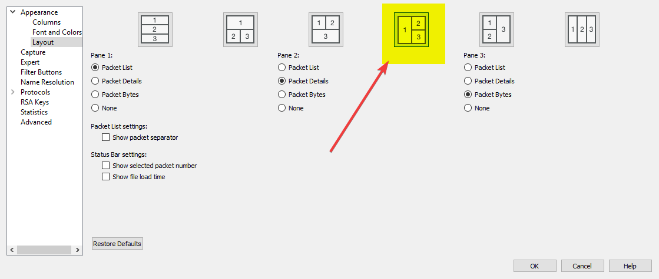
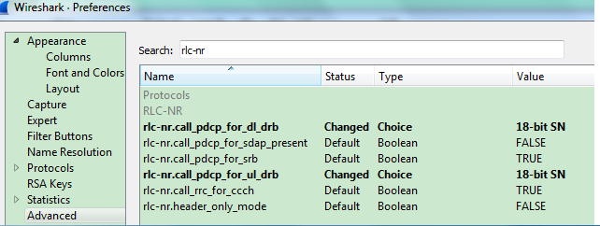
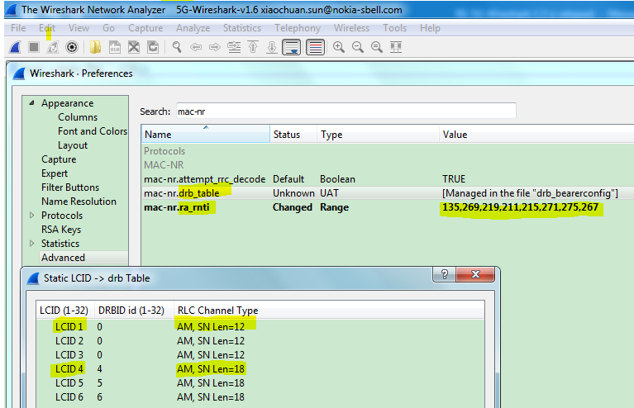
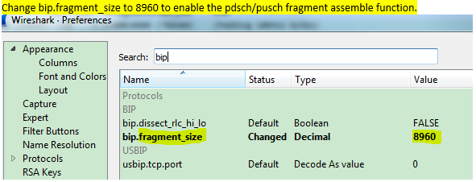
How to decode L1-L2 BIP .pcap – 5G-Wireshark
Configure WS preferences:
Always use the only proper layout!
Change protocol settings:

Slide 17
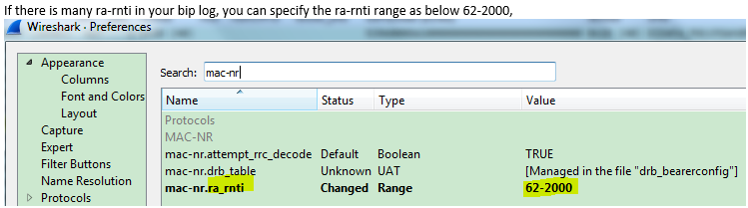
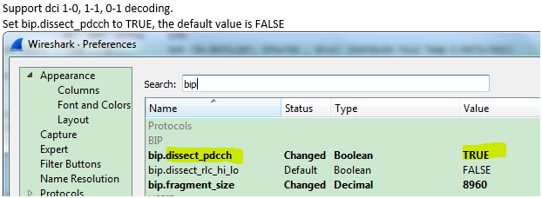
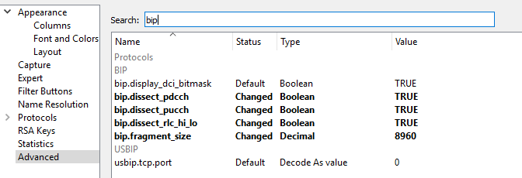
How to decode L1-L2 BIP .pcap – 5G-Wireshark
3. Change protocol settings:

Slide 18
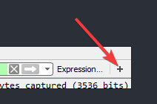

How to decode L1-L2 BIP .pcap – 5G-Wireshark
4. Display filter save (Add display filter button)

Slide 19
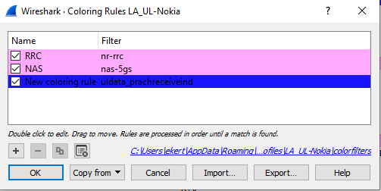
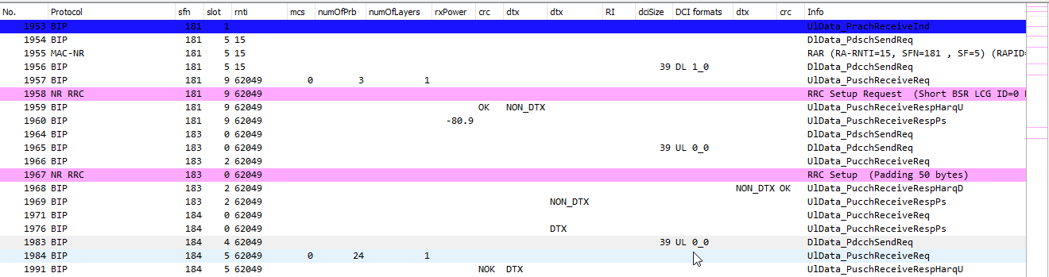
How to decode L1-L2 BIP .pcap – 5G-Wireshark
5. Coloring Rules
You can use build before display filter
to mark packages

Slide 20
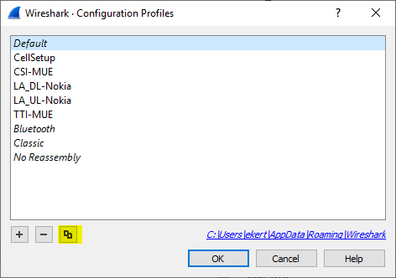
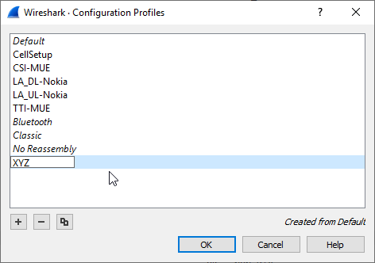
How to decode L1-L2 BIP .pcap – 5G-Wireshark
6. Configuration Profiles
All personal configs will be saved under new profile

Slide 21
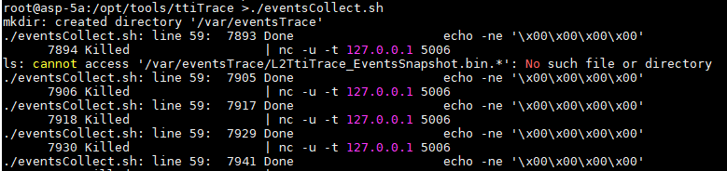
How to capture L2-PS TTI traces - ABIL
https://confluence.int.net.nokia.com/display/5GFTUlm/TTI+traces#TTItraces-RemarktoeventSnapshotDecoder
root@fct-4a:~ >bsh 1:0
root@asp-5a:~ >cd /opt/tools/ttiTrace
root@asp-5a:~ >./eventsCollect.sh
Traces will be saved in /var/eventsTrace/
Unpack files: tar xvzf /var/eventsTrace/L2TtiTrace_EventsSnapshot.bin.1.tar.gz
Decode ./eventDecoder L2TtiTrace_EventsSnapshot.bin.1 ./
You should received 3 .csv files
To speedup capturing you can use attached script ☺
Copy it to ABIL Master (bsh 1:0) and execute ./gnb_tti_traces_v3.sh start/stop
It will capture and decode all files

Slide 22
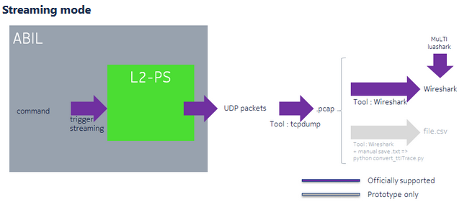
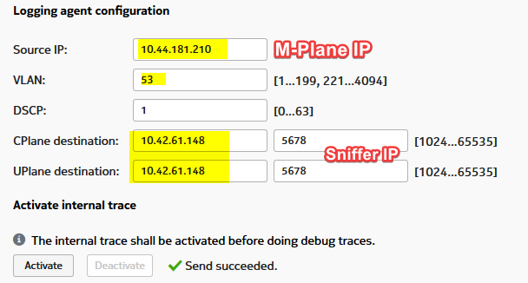
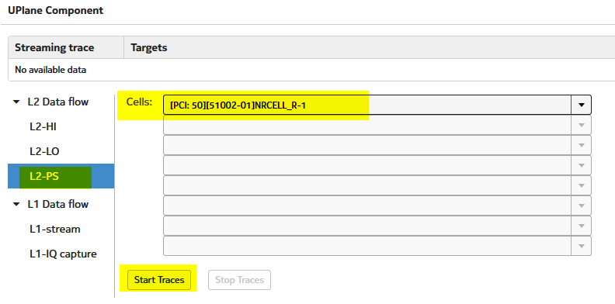
How to capture L2-PS TTI traces - Sniffer
To capture TTI traces at sniffer, we need to use L2-PS Events Streaming mode
To activate tti traces streaming mode, we have 2 ways:
O&M
In Web EM -> Diagnostic -> Debug Tracing
Configure IPs
Configure Uplane traces
LABNET
10.44.181.210
10.42.61.148

Slide 23

How to capture L2-PS TTI traces - Sniffer
b. ASIK commands
Enable icom mode: # /opt/trs/bin/trs-vppctl icom 630_mode enable
Set Classical mode: # /opt/trs/bin/trs-vppctl icom classical_mode enable
Configure stream Ips: # /opt/trs/bin/trs-vppctl icom set_stream_conf src_ip 10.44.181.210 dst_ip 10.42.61.148 dscp 32 dst_port 5678
Note: IPs used in command should be pingable in both directions.
Check L2-PS node ID (9274, 9018, 8761, 5178, 4922, 4666)
START traces:
# curl -i -H "Content-Type: application/json" -X POST -d '{"key":{"nodeId":9274, "upSw":"l2ps", "traceType":"component"},"data":{ "state":"start", "eqId":537395200, "pciList":"[50]" }}' http://127.0.0.1:8008/troubleshooting/l2Stream
If needed STOP tti trace streaming:
# curl -i -H "Content-Type: application/json" -X POST -d '{"key":{"nodeId":9274, "upSw":"l2ps", "traceType":"component"},"data":{ "state":"stop", "eqId":537395200, "pciList":"[50]" }}' http://127.0.0.1:8008/troubleshooting/l2Stream
Start tcpdump at sniffer on configured interface: #tcpdump -i ens255f0 -u port 5678 -w tti.pcap

Slide 24
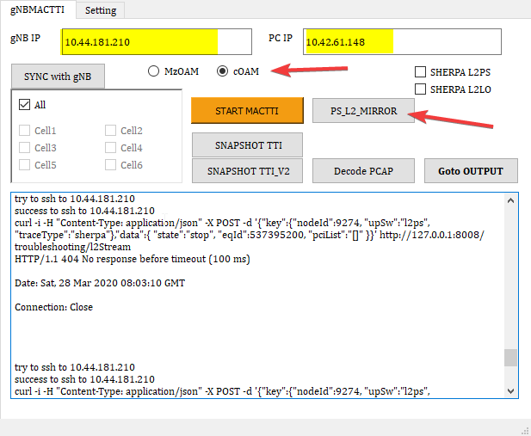
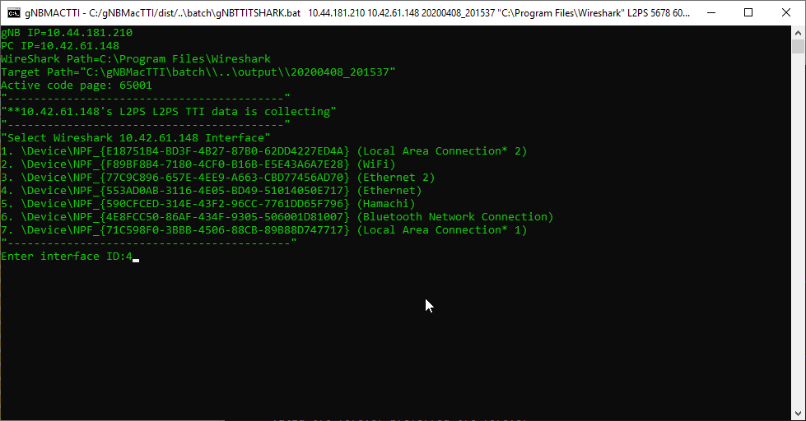
How to capture L2-PS TTI traces - Sniffer
b. v2. To faster setup, you can use gNBMACTTI tool, developed by KRD (for Classical only!).
You can use Your PR as a sniffer, if gNB is pingable from PC ☺
Replace „PC IP” with ip of your network adapter
Press „START MACTTI”
Chose Interface ID – in my case it is =4
To stop press „Stop MACTTI”

Slide 25
How to decode TTI traces (.pcap)
You need machine with installed Centos 8, or Debian 9
Download tool ttitrace-X.YYY.ZZZ.txz from WFT, or directly from artifactory
Extract it
Add execution right: # chmod +x ./decodeAndAnnalyze
Go to ./decodeAndAnalyze/bin/
To decode .pcap file execute command: #./eventDecoder /path/to/ttitraces.pcap filename
You will get 3 .csv files: .dl.csv, .ul.csv, .dlAndUl.csv
Files are in format: Event_name:headers,values
To have more use full format to analysis, we need to convert it again. To do it we can use Bipper

Slide 26
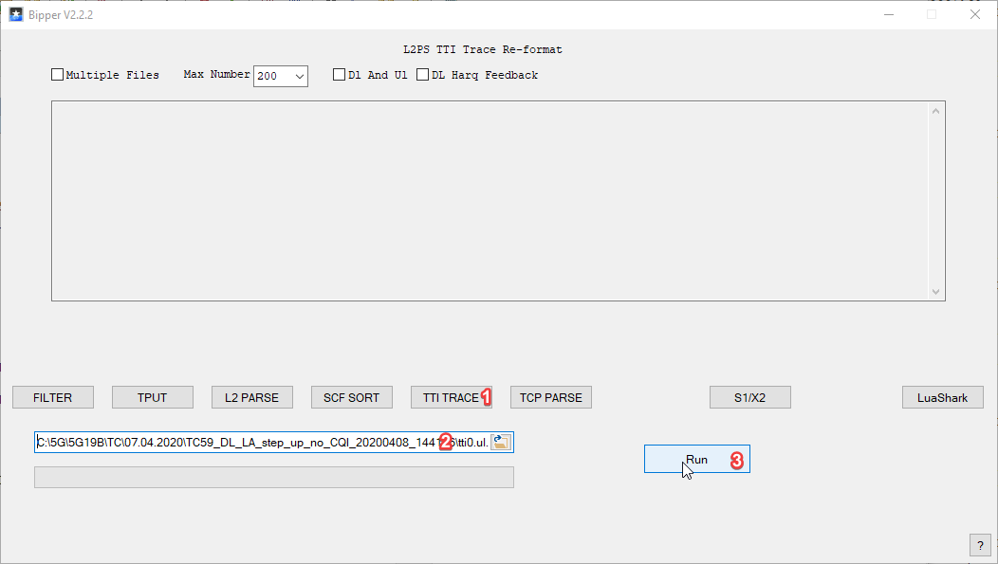
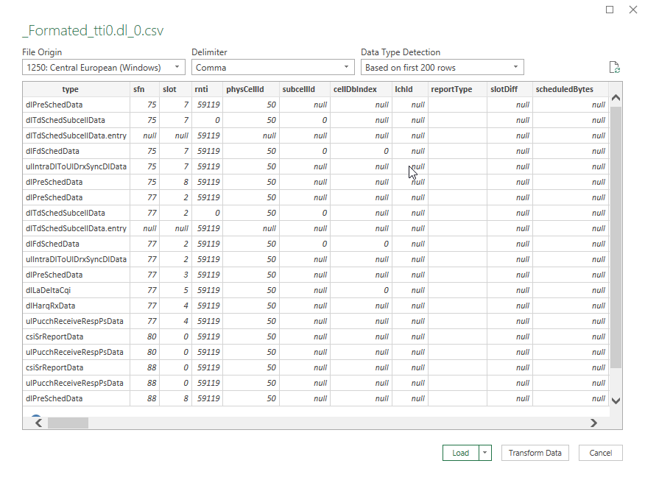
How to decode TTI traces - Bipper
You can download it from here
Go to TTI TRACE tab, choose .csv file to decode and start decoding:
Output file can be opened in excel
Data -> From Tex/CSV -> choose „comma” as Delimiter, and Load

Slide 27
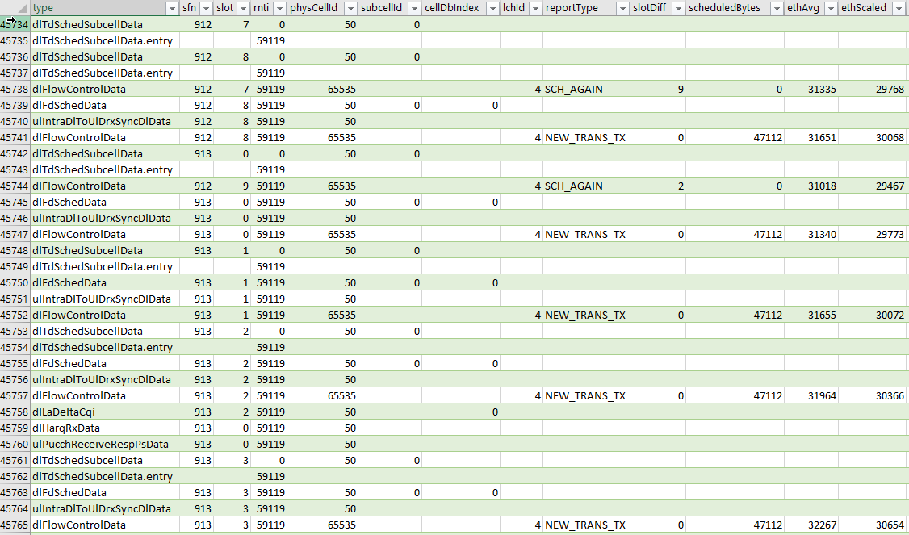
How to decode TTI traces - Bipper

Slide 28
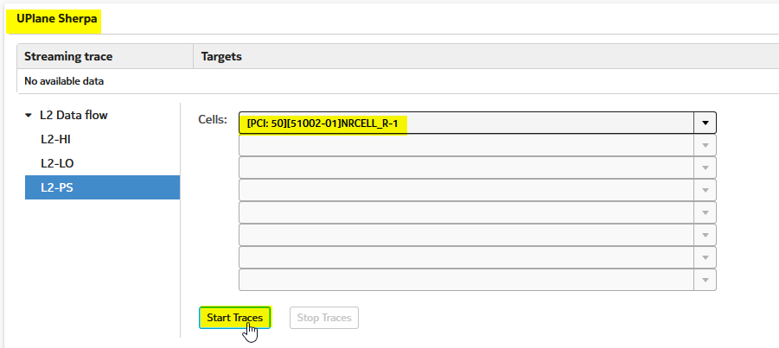
How to capture L2 Sherpa traces - Sniffer
To capture Sherpa traces at sniffer, we need to use L2-PS Sherpa Streaming mode
To activate tti traces streaming mode, we have 2 ways:
O&M
In WeB EM -> Diagnostic -> Debug Tracing
Configure IPs
Configure Uplane Sherpa
LABNET
10.44.181.210
10.42.61.148

Slide 29
How to capture L2 Sherpa traces - Sniffer
2. You can use similar ASIK commands, as in TTI logs collecting case
Enable icom mode: # /opt/trs/bin/trs-vppctl icom 630_mode enable
Set Classical mode: # /opt/trs/bin/trs-vppctl icom classical_mode enable
Configure stream Ips: # /opt/trs/bin/trs-vppctl icom set_stream_conf src_ip 10.44.181.210 dst_ip 10.42.61.148 dscp 32 dst_port 5678
Note: IPs used in command should be pingable in both directions.
Check L2-PS node ID (9274, 9018, 8761, 5178, 4922, 4666)
START traces:
# curl -i -H "Content-Type: application/json" -X POST -d '{"key":{"nodeId":9274, "upSw":"l2ps", "traceType":"sherpa"},"data":{ "state":"start", "eqId":537395200, "pciList":"[50]" }}' http://127.0.0.1:8008/troubleshooting/l2Stream
If needed STOP tti trace streaming:
# curl -i -H "Content-Type: application/json" -X POST -d '{"key":{"nodeId":9274, "upSw":"l2ps", "traceType":"sherpa"},"data":{ "state":"stop", "eqId":537395200, "pciList":"[50]" }}' http://127.0.0.1:8008/troubleshooting/l2Stream
Start tcpdump at sniffer on configured interface: #tcpdump -i ens255f0 -u port 5678 -w sherpa.pcap

Slide 30
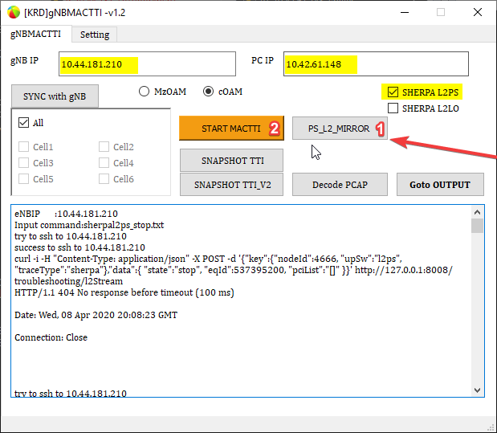
How to capture L2 Sherpa traces - Sniffer
b. v2. To faster setup, you can use gNBMACTTI tool, developed by KRD.
You can use Your PR as a sniffer, if gNB is pingable from PC ☺
Replace „PC IP” with ip of your network adapter
Press „START MACTTI”
Chose Interface ID – in my case it is =4
To stop press „Stop MACTTI”

Slide 31
How to capture Sherpa traces
How to get license, logs analysis:
https://confluence.int.net.nokia.com/pages/viewpage.action?spaceKey=5GSH&title=Trace+Analysis+005%3A+How+to+use+Sherpa
Config Sherpa traces from O&M:
https://confluence.int.net.nokia.com/pages/viewpage.action?spaceKey=CSRNS5G&title=How+to+get+traces+with+Sherpa
Sherpa training video:
https://nokiaedu.webex.com/nokiaedu/lsr.php?RCID=30372ca62a1748eebcd4e94d06a79813
+ one more confluence:
https://confluence.int.net.nokia.com/pages/viewpage.action?spaceKey=5GFTUlm&title=Sherpa+-+graphical+tool+for+Uplane+logs

Slide 32
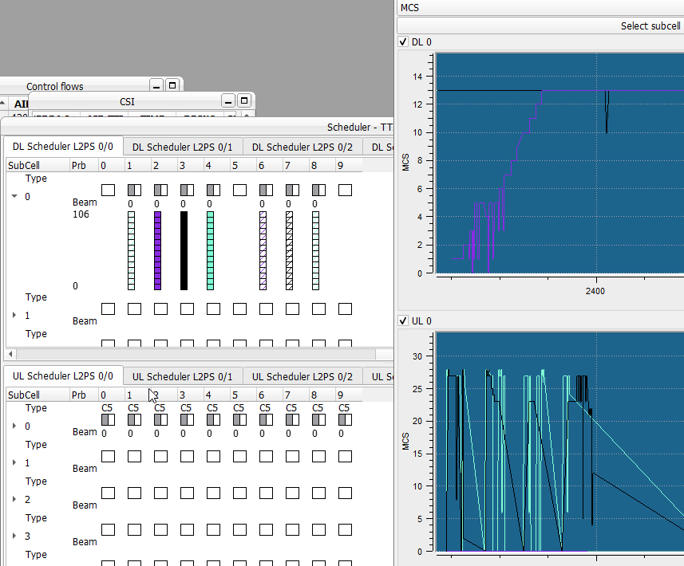
Sherpa – Examples
Log -> FDD_2_sherpa
2 modes:
Micro
Scheduling per tti
Control flows, Sizes flows
Macro
Charts
Stats

Slide 33
DDR4/IQ data L1 capture – CPRI ONLY !
For L1 logs capturing -> Loner Problem Solving
For DL: Example command for one frame, execute it on loner:
asp-5c:~# snapshot --end_addr 0x412BFFFC leka_tx_0
Example command for maximum capture size (this big file can cause reset, check file system space with command: df .):
asp-5c:~# snapshot --end_addr 0x57FFFFFC leka_tx_0
For UL: Example command for two frames:
asp-5c:~# snapshot --end_addr 0x412BFFFC leka_rx_0
Example command for maximum capture size (this big file may cause reset, check file system space with command: df):
asp-5c:~# snapshot --end_addr 0x57FFFFFC leka_rx_0

Slide 34
Triggered I/Q Capture on Loner (only 5G19A and later) – CPRI ONLY !
Example for PRACH MSG 1 Capture
Disable capture on event in webEM or webUI L1-IQ capture configuration.
Untick the box named "Enable capture on event". Select Operation option Configure.
Locate 2 files in loner
/etc/5g-layer-1/test_modes.conf
/etc/5g-layer-1/rd_parameters.conf
4. Edit test_modes.conf
prach_snapshot_test_mode = 1
5. Edit rd_parameters.conf
prach_peak_metric = x.y
You can find suitable values on BIP capture with filter:
UlData_PrachReceiveInd.detectedPrachPreambles_item_63.peakMetric > x.y
This is threshold value. The trigger will occur on any peak metric value that is bigger than x.y.

Slide 35
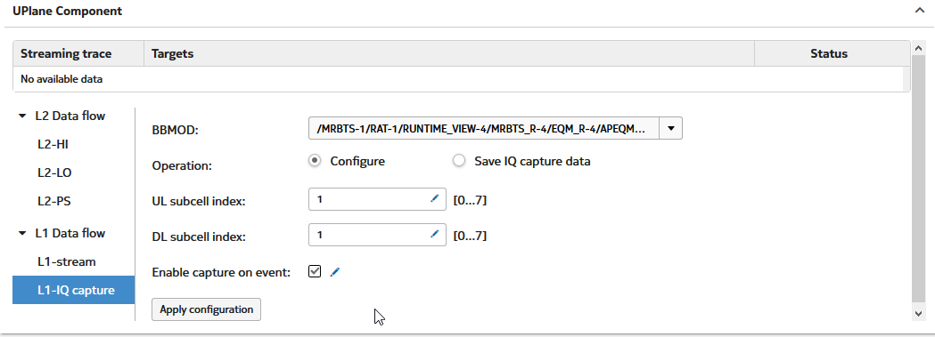
Triggered I/Q Capture on Loner (only 5G19A and later) – CPRI ONLY !
Select subcell in webEM or webUI antenna snapshot configuration.
Enable capture on event in webEM or webUI L1-IQ capture configuration. Select Operation Configure and tick box "Enable capture on event". Press "Apply configuration" button.
Start the test.
Wait for the trigger to occur. Log into Loner and wait until this command shows something:
journalctl -f | grep "UTU BCN"
Wait 2 minutes so that the IQ capture files are fetched automatically from Loner.
Take a snapshot after the fault occurred.
The IQ captures will be in the snapshot in file named *_IqSamples.tgz.
Moore examples : https://confluence.int.net.nokia.com/pages/viewpage.action?pageId=851069961

Slide 36
DDR4/IQ data – decoding TigerSailor
Tbd ->tiger sailor (license problem)
Confluance: https://confluence.int.net.nokia.com/display/5GSH/Trace+Analysis+004%3A+TigerSailor+for+analyze+antenna+IQ+signals

Slide 37
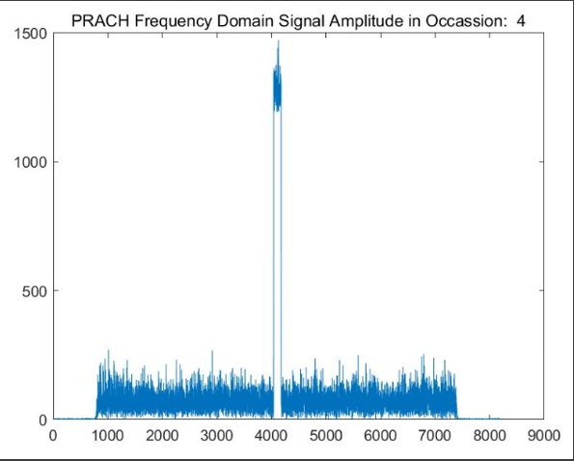
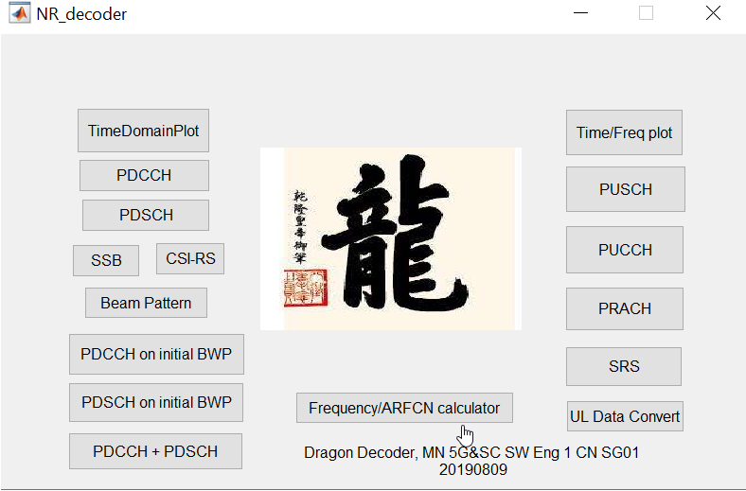
DDR4/IQ data – decoding Dragon Decoder
Download:
Confluance: https://confluence.int.net.nokia.com/display/5GSH/Trace+Analysis001%3A+Dragon+Decoder+for+DDR4+IQ+data+decode
Examples: https://confluence.int.net.nokia.com/display/5GSH/Trace+Analysis+01%3A+Dragon+Decoder+for+DDR4+IQ+data+decode

Slide 38
MUE TDD examples
TDD_MUE_log1 (log)
[1]5GC000523_D_CSI_RS_CSI_reports_check_MultiUE_4UE_UE_ULDL_goodRF_aBF
2. TDD_MUE_13UE (log)
[1]5GC000523_E_Configurable_CSI_Periodicity_80sl_13UEs_aBF
3. TDD_MUE_proact (log)
[1]5GC000523_AB_Multi_UE_ULDL_Proactive_Scheduling_mmWaves
4. TDD_MUE_mRACH (log)
[1]5GC000523_E_RACH_Priority_Handling_2UEs_aBF

Slide 39
MUE FDD examples
1. FDD_1_4UE (log)
[1]5GC001178_BE_5_SR_handling_1UE_UL_20MHz_bandwidth
2. FDD_1_4UE (log)
[1]5GC001178_BE_1_2UE_Attach_20MHz_bandwidth
3. FDD_4_MCS_PRB (log)
[1]5GC001178_BE_8_MCS&PRB_Reduction_4UEs_UL_varRC_20MHz_bandwidth
4. FDD_3_Proact (log)
[1]5GC001178_BE_13_Proactive_scheduling_4UEs_20MHz_bandwidth

Slide 40
LA FDD examples
1. FDD_5_DL_LA (log)
[1]5GC001796_EB_TC18_DL_LA_64QAM-table_MIMO_4x4_PTRS-ON_from_Near_to_Edge_Cell_radio_condition_BW-15MHz_SA
2. FDD_4_MCS_PRB_DL_LA (log)
[1]5GC001796_EB_TC30_UL_LA_64QAM-table_PTRS-ON_from_Edge_to_Near_Cell_radio_condition_BW-15MHz_SA

Slide 41
Q&A

Slide 42
Useful links
https://www.google.com/
https://confluence.int.net.nokia.com/ -> Search
ShareTechNote
http://www.sharetechnote.com/html/5G/Handbook_5G_Index.html
gNB internal communication
5G19B_e2e_internal_communication
NR Throughput Tool
http://5gtables.eecloud.dynamic.nsn-net.net/nrTput.php?code=EUQBAEAAAAAEAwAAAAAAAAAA
NR frequency band
http://niviuk.free.fr/nr_band.php
5G Uplane Sw Arch doc
https://5gwebserver.eecloud.dynamic.nsn-net.net/CinqG/uplaneSwDoc/docGen/doc/All_UplaneSwArchiDoc.html#_debugging_guide

